Slide 1
Windows Tech Series Base Setup for Management
Speaker 1
Title
Speaker 2
Title

Slide 2
Agenda
Day | Day 1 Deployment | Day 2 Management | Day 3 Security | Day 4 Windows for CSP
 |  |  |  | Deployment | Management | Security
Synopsis | Module 1 – Introduction | Module 1 – Base System Setup | Module 1 – Analysis Of Common Threats | Module 1 – Windows for SMB Partners
 | Module 2 – Applications & Updates | Module 2 – Configuration | Module 2 – Hardening Windows | Module 2 – Windows Ent. Subscription
 | Module 3 – Windows as a Service (WaaS) | Module 3 – Managing Client Devices | Module 3 – Advanced Threat Protection | Module 3 – Deployment
 | Module 4 – Browsers & Internet Security | Module 4 – Advanced management options I | Module 4 – Information Security (RMS/EDP) | Module 4 – Managing Updates
 | Module 5 – Secure Boot & Device Guard | Module 5 – Advanced management options II | Module 5 – Internet Security

Slide 3
Part 1 – Base System Setup
Azure AD & EMS setup and configuration
Intune setup and initial configuration
Azure Active Directory Domain join
Configure Azure AD connect

Slide 4
Windows offers the management features that businesses need.
Notes:
This has been true for a long time: Windows contains many management features designed to meet the needs of businesses. This legacy goes back many years, with capabilities that started in Windows for Workgroups 3.11 and has continued to evolve since.

Slide 5
Business needs are evolving. Windows 10 offers management choices to meet those needs.
Notes:
But of course your needs continue to evolve, and Windows will continue to evolve with it. That doesn’t mean that Microsoft radically overhauls what they’re currently doing. Instead, Microsoft is looking to add new capabilities, and in some cases entirely new scenarios, for managing Windows. As a result, they believe Windows 10 will have the best set of management choices – they’ll have a solution, regardless of your specific scenario or scenarios.

Slide 6
Evolving Business Needs
Recent Past
9-to-5 Monday-Friday employees at work
PCs on a LAN, connected to domain
Corporate supplied and managed devices
One device ecosystem
Extended operating system/servicing lifecycle
On-premises applications and file sharing
Access controls contained within organizational
Deep corporate management controls and policies
Malware as vandalism and criminal activity
Network perimeter as a viable defense boundary
Vertically-integrated devices for task workers
Mobile-first, Device-first
24x7x365 blur of work & personal activity
Laptops, tablets, phones anywhere (on any network)
Corporate and BYOD, business & personal apps/data
Heterogeneous ecosystems (Windows, iOS, Android, Chrome)
A faster upgrade cadence; shorter device lifecycle
SaaS applications and file sharing services
Access controls span organizations, apps, individuals
Lighter cloud-based management with fewer controls
Malware as espionage and weaponry
Must operate under assumed breach of network
Dynamically adapting devices for task workers
Notes:
So what does Microsoft mean when they say that business needs are evolving? Many things: a shift towards a mobile workplace, a realization of heterogeneous ecosystems, bring your own device (BYOD) and choose your own device (CYOD) scenarios, the cloud, and more. Most importantly, the rate of change is increasing, which is why they’re investing in new scenarios and capabilities: They want Windows to remain the best-managed platform, regardless of how you are using it.

Slide 7

Management Choices
Works with existing infrastructure
Continued support for Group Policy and WMI
Advanced MDM support
Consistent across PC/phone
1st and 3rd party solutions
Notes:
At a high level, they have two main choices: Traditional management, with Group Policy, System Center, and related components; and Mobile Device Management (MDM), which Microsoft has added in Windows 8.1 and continues to enhance. In Windows 10, they’ll greatly expand the MDM capabilities while shifting to a consistent implementation across phone and PC devices, and of course they’ll support both their own Intune service as well as other third-party MDM solutions.

Slide 8
Management Choices
 | Available Choices
Identity | Active Directory; Azure Active Directory
Management | Group Policy, System Center Configuration Manager, 3rd party PC management; Intune, 3rd party MDM
Updates | Windows Update; Windows Server Update Services (WSUS); Intune, 3rd party MDM
Infrastructure | On-premises or in the cloud
Ownership | Corporate-owned, CYOD; BYOD
Organizations may mix and match, depending on their specific scenario
Notes:
But really there’s more to it than just what management tool you use. There are choices in several areas.
For identity Microsoft will continue supporting Active Directory and domain-joined computers, while also directly supporting Azure Active Directory and “logon to the cloud.”
From a management perspective, Group Policy and Configuration Manager (or other 3rd party PC management tools) will continue to provide the greatest functionality, while Intune and third-party MDM services will provide lightweight mechanisms for managing Windows devices in appropriate scenarios.
For updating Windows systems, Microsoft will continue supporting Windows Update (where they automatically update devices as those updates are released) and WSUS (including with System Center Configuration Manager) where you control when updates are deployed. But they’ll also add new MDM capabilities, where Intune and third-party MDM services can also control the Windows updating process.
Overall these choices reflect the type of infrastructure being used to manage the devices. Whether on-premises or in the cloud, Windows 10 will support your choices.
Microsoft thinks this scenarios also aligns well with device ownership – you may choose to manage corporate-owned devices (including “choose your own device” (CYOD) scenarios) differently from “bring your own device” (BYOD) employee-owned devices.
Microsoft doesn’t expect a one-size-fits-all solution, as you can pick the combination that makes the most sense for specific device usage scenarios.

Slide 9
Management Choices
Basic
Lightweight
Full Control
Exchange ActiveSync
Active Directory and/or Azure Active Directory
Mobile Device Management
Active Directory
Group Policy
System Center
Windows Update
Windows Update/MDM
WSUS
BYOD (personal) devices
E-mail access only
Company-owned and BYOD devices
Internet-facing or corporate network
Company-owned devices
Corporate network
Notes:
When Microsoft looks at how these technologies are typically used together, they see three groupings: Basic controls, provided through Exchange ActiveSync for the most basic needs, e.g. e-mail access; Lightweight controls, for either company-owned or personal devices where more management is needed or desired; and Full Control where Group Policy, System Center, and WSUS provide extensive capabilities that target company-owned devices (typically connected to the corporate network).

Slide 10



Windows Management Features
Products
System Center Configuration Manager Microsoft Desktop Optimization Pack (MDOP)
Cloud Services
Azure Active Directory Azure RMS Microsoft Intune Windows Store Windows Update
Windows Server
Active Directory Group Policy Windows Server Update Services (WSUS)
Windows Client
Windows Management Instrumentation (WMI) Windows Remote Management (WinRM) Windows Update Group Policy Client
Mobile Device Management (MDM) PowerShell AppLocker
Notes:
When looking at the specific Windows features that support these management scenarios, you can see that Microsoft builds many into Windows itself. They’ll continue to enhance these in Windows 10. But they also leverage features of Windows Server, System Center, and MDOP to provide complete on-premises management.
With Windows 10, Microsoft will also fully embrace cloud services, beyond just Intune and MDM, with built-in support for Azure Active Directory, Azure RMS, and more.

Slide 11
Windows 10 Works with Existing Infrastructure
Product | Supports Windows 10 Management | Supports Windows 10 Deployment
System Center 2012 R2 Configuration Manager
System Center 2012 Configuration Manager
System Center Configuration Manager 2007
Windows Server 2012 R2 Windows Server 2012 Windows Server 2008
Microsoft Deployment Toolkit 2013
Updates will be required. New OS features may require newer versions for full support.
Notes:
In the case of on-premises infrastructure, Microsoft wants to ensure that your existing infrastructure doesn’t require any major upgrades in order to support Windows 10. To support that, existing System Center and Windows Server versions will fully support the management and deployment of Windows 10. There may be some updates required to add this support, but they’ll be sure to make those available at or before the Windows 10 release. (Microsoft will also update MDT 2013, their free deployment tool, to support Windows 10 deployment.)
They’re also working on a new version of System Center Configuration Manager, as well as a new version of Windows Server. These new versions, which will be available after the Windows 10 release, will offer some new capabilities related to new Windows 10 features, but these aren’t mandatory for the Windows functionality you use today.

Slide 12
Mobile Device Management
Significant investments in added functionality for both mobile and desktop devices
Fully managed corporate device
Device Lockdown
BYOD: simple security settings
Phone
Desktop
Phone
Desktop
Notes:
Microsoft introduced mobile device management (MDM) capabilities in Windows 8.1 and Windows Phone 8.1. For PCs, these capabilities focused on BYOD scenarios, such as ensuring the devices met your security requirements before they could access corporate e-mail and resources. For Windows Phone 8.1, these capabilities went a little further, enabling more “device lockdown” capabilities for configuring special-purpose devices for running specific line-of-business apps.
As we move to Windows 10, Microsoft will greatly expand these capabilities to provide much more robust capabilities. It’s important to note that they’re not just going to recreate the 3,600 group policy settings that Windows has today. Instead, they’ll provide an appropriate set of high-level capabilities. Microsoft encourages you to check out the full list of settings as they get closer to the Windows 10 release and to let them know what additional settings might be required for your organization.

Slide 13
MDM in Windows 10
Unenrollment with alerts
Removal of Enterprise configuration (apps, certs, profiles, policies) and Enterprise encrypted data (with EDP)
ENROLLMENT
Provisioning
Bulk enrollment
Simple bootstrap
Converged protocol
Azure AD Integration
UNENROLLMENT
One consistent set of MDM capabilities across Mobile, Desktop, and IoT
INVENTORY
Full device wipe
Remote Lock, PIN reset, Ring, & Find
Enhanced inventory for compliance decisions
Additional device inventory
Curated Windows Store
Business Store Portal (BSP) app deployment; license reclaim
Enterprise App management
Simplified LOB app management
Win32 (MSI) app management
App inventory (LOB/store apps)
App allow/deny lists via Applocker
Enterprise data protection
REMOTE ASSISTANCE
Extended set of policies Client certificate management
Enterprise Wi-Fi
VPN management
Email provisioning
MDM Push
Device Update control
Kiosk, Start screen, Start menu configuration and control
DEVICE CONFIGURATION AND SECURITY
APPLICATION MANAGEMENT
Notes:
The MDM capabilities provided in Windows covers the complete lifecycle of the device.
In Windows 10, these will be enhanced with additional capabilities in each phase of that lifecycle. While the complete list of new functionality is still being defined, here are some examples of new MDM capabilities that Microsoft expects to deliver.
They’ll provide easy enrollment capabilities to automate the MDM enrollment of the device as part of the Azure Active Directory join process.
They’ll provide new controls for configuring and managing the Start menu.
They’ll enable new controls over Windows updates, allowing you to control when specific Windows updates are deployed to MDM-managed devices (think “WSUS from the cloud”).
They’ll provide new AppLocker and Enterprise Data Protection configuration settings.
They’ll enable integration with the Windows Store and the Business Store Portal (BSP) to enable automated app management.
They’ll provide full device wipe capabilities, even for PCs.
These capabilities will be supported on all types of devices, including Windows phone devices, PCs and tablets, and Internet-of-Things (IoT) devices.

Slide 14

Identity Choices
Active Directory provides key business identity and security capabilities
Azure Active Directory takes this to the cloud
Both work together
Windows 10 fully leverages both
Notes:
Let’s talk more about the choices in Identity. Of course we need to start by talking about Active Directory, which is used by almost all businesses today to provide identity, security, and more. Microsoft will continue to fully support all the Active Directory capabilities in Windows 10 – no surprise there. (They also have Microsoft accounts, which are effectively a consumer identity system. These can still be used with Windows 10 as well.)
The biggest change related to identity in Windows 10 is the full support of Azure Active Directory. This means that Windows 10 is fully aware of Azure Active Directory accounts and services, and can leverage these in several ways that we’ll talk about it a little while.
It’s important to understand that this doesn’t mean choosing one or the other. For organizations with existing Active Directory domains, you’ll use these together to provide additional capabilities.

Slide 15

Windows 10 Identity Choices
Organization Owned
Personally Owned (BYOD)
Active Directory
Azure Active Directory
Computer joins AD to establish trust
User signs on using AD account
Group Policy + System Center
Computer joins Azure AD to establish trust
User signs on using Azure AD account
Intune/MDM
Settings roaming
Computer registers with AD or Azure AD via Device Registration to establish trust for remote resource access
User signs in with a Microsoft account, associates an Azure AD account
Intune/MDM
Single sign-on to enterprise + cloud-based services
Notes:
As previously mentioned, Microsoft can support management of both organization-owned devices and personally-owned (BYOD) devices. When talking about identity, this is of course also true.
For organization-owned devices, you can join these into an Active Directory domain in order to establish trust, then sign on with an Active Directory account. Management is provided via Group Policy and System Center, working together. (Note that this isn’t supported by Windows phone devices; Azure Active Directory is supported though.)
Or you can join them into an Azure Active Directory tenant, and then sign on using an Azure Active Directory account, with full support for roaming of app settings and data through Azure storage (still a work-in-progress). In this case, you would typically manage the device using Intune or a third-party MDM service.
But the real value comes when you combine the two: After synchronizing your Active Directory domain with Azure Active Directory, there are additional single sign-on benefits. Microsoft automatically recognizes the association between the AD and Azure AD accounts, which enables Active Directory users to seamlessly access cloud-based services without having to provide their credentials again. And Azure AD users can access on-premises services without needing to do anything else.
When talking about cloud-based services, we don’t just mean the Microsoft-provided ones – you would expect seamless access to the Windows Store, Intune, Office 365, and other services built around Azure AD. But Microsoft will also provide single sign-on to hundreds of additional SaaS (software as a service) offerings from many different providers. All you need to do is define the connection between Azure AD and these services (normally a simple wizard-driven process) and you’re all set.
For personally-owned devices, Microsoft will support “device registration” (formerly called “Workplace Join”) to register a personal device. Once registered, you can be assured of an additional level of trust: Having the user’s credentials by themselves might not be good enough (because someone might have been able to obtain their password), but if they are using a trusted device, then access would be allowed. Microsoft will continue to build on these “conditional access” capabilities. These personally-owned devices can also be managed using Intune or an MDM service too.

Slide 16
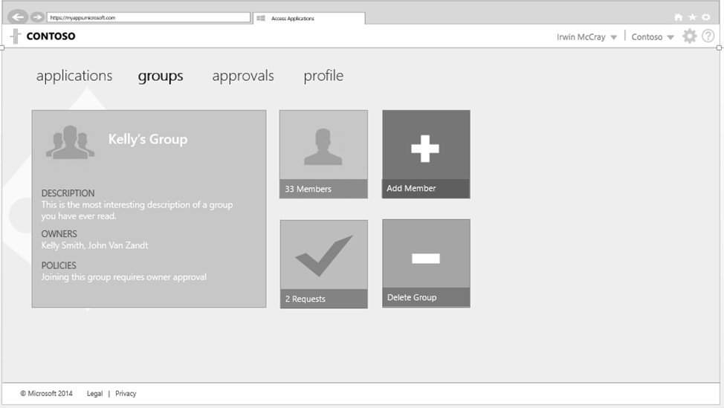
Azure Active Directory
Simple connection
Self-service
Single sign on
Windows Server
Active Directory
Username
•••••••••••
Other Directories
SaaS
Azure
Intune
Office 365
On-premises
Cloud
Microsoft Azure Active Directory
Notes:
To use Azure Active Directory, you first need to set up an Azure Active Directory tenant for your organizations. (If you are already using Intune or Office 365, you already have one. If not, it’s easy to set up a new one, typically for free.) Once you have set up the Azure AD tenant, you can set up synchronization between your existing Active Directory domain and Azure Active Directory through a free synchronization utility (Azure AD Sync now, Azure AD Connect coming soon) which is quickly configured via a wizard and then runs periodically to keep Azure AD up to date.
PCs and devices can join Azure Active Directory, or they can just leverage Azure AD accounts. Either way, they then have single sign-on access to cloud-based services and get automatic roaming of app settings and data between all types of Windows devices. (Settings related to these organization accounts is kept separate from Microsoft accounts personal settings.)

Slide 17
Azure AD Join

Slide 18
Azure
Device Registration
Service
Microsoft Azure
Active Directory
Intune
10

Slide 19
Azure
Device Registration
Service
Microsoft Azure
Active Directory
Azure AD username and Password (+ MFA if enabled)
Intune
10

Slide 20
Azure
Device Registration
Service
Microsoft Azure
Active Directory
Azure AD returns ADRS SSO Token, Local admin accounts and MDM URL’s
Intune
10

Slide 21
Azure
Device Registration
Service
Microsoft Azure
Active Directory
Win 10 then performs a device registration against ADRS using token provided by Azure AD
Intune
10

Slide 22
ADRS writes a device object to Azure AD
Azure
Device Registration
Service
Microsoft Azure
Active Directory
Intune
10

Slide 23
Azure
Device Registration
Service
Microsoft Azure
Active Directory
ADRS issues a device registration certificate to the client
Intune
10

Slide 24
Azure
Device Registration
Service
Microsoft Azure
Active Directory
MDM URL’s passed to MDM Enrollment Agent
Intune
10

Slide 25
Azure
Device Registration
Service
Microsoft Azure
Active Directory
MDM Agent connects to Azure AD for SSO token to access MDM application
Intune
10

Slide 26
Azure
Device Registration
Service
Microsoft Azure
Active Directory
Azure AD returns MDM SSO Token
Intune
10

Slide 27
Azure
Device Registration
Service
Microsoft Azure
Active Directory
Intune
10
MDM Agent uses SSO Token to start MDM enrollment

Slide 28
Azure
Device Registration
Service
Microsoft Azure
Active Directory
Intune
10
MDM enrolls device and pushes down policy to Windows 10

Slide 29





Device Management Vision A “single pane of glass” for managing all of your devices
Windows PCs
(x86/x64, Intel SOC),
Windows To Go,
Windows Embedded
Organization-owned, on-premises
Single admin
console
IT Administrator
Windows PCs
(x86/x64, Intel SOC)
Windows mobile/phone devices
Organization-owned or personally-owned (BYOD), internet-connected
iOS / Android
Intune
Notes:
Remember initially Microsoft recommended that you should make choices based on scenario? That means you could have one group of devices managed using on-premises services like Active Directory Group Policy and System Center Configuration Manager, while another group of devices could be leveraging Azure Active Directory and Intune.
But that doesn’t mean that you need to manage these separately. The Microsoft enterprise client management team has been working for some time on ensuring that you can manage both sets of devices from a single administrative console. This means that you only need to define apps once; you only need to create one set of policies; and you get all inventory in one central place.
[This vision reflects something that analysts have been saying for some time: While separate MDM vendors have sprung up to fill in the gaps caused by the creation of these new cloud-based services, eventually organizations will come to realize that having a single management solution for all devices will be advantageous – without that meaning that you have to give up existing capabilities that you use today with traditional on-premises solutions like System Center and Group Policy.)

Slide 30
Group Policy
New in Windows 10
New from Windows 7
New policies to support Windows 10 features:
Start screen and start menu management
“Project Spartan” settings
Next-Generation Credential PIN settings
Universal app management
Capabilities from Windows 8.1:
Policy caching
IPv6 support for printers, VPN, targeting
Capabilities from Windows 8:
Sign-in optimization for DirectAccess clients
Better use of larger registry policies (registry.pol)
Remote group policy refresh (GPUpdate)
More efficient background processing
Notes:
For those using Active Directory and Group Policy to manage organization-owned devices, Microsoft will of course provide new policies to support Windows 10 features like the new “Project Spartan” browser, Next-Generation Credentials, Start screen and start menu controls, and more. They want to ensure that it’s easy for you to drop new Windows 10 devices into your infrastructure and manage them like you do today.
Since many of you are still using Windows 7, it’s important to also point out the Group Policy investments that Microsoft made in Windows 8 and Windows 8.1. Many of these changes were to improve the overall performance of Group Policy, especially when devices are connected across slow network links or DirectAccess. Microsoft also improved support for larger policies and added support for other new capabilities added in those releases, such as with IPv6 and VPN.

Slide 31


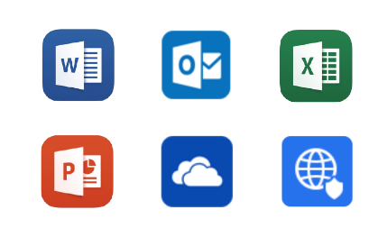




Microsoft Intune
Mobile Device Management
Mobile Application Management
PC-Management
Benutzer
IT
Notes:
In this module we are creating the base for the next modules with setting up the following components:
Microsoft Intune as MDM platform to achieve centralized mobile device management

Slide 32
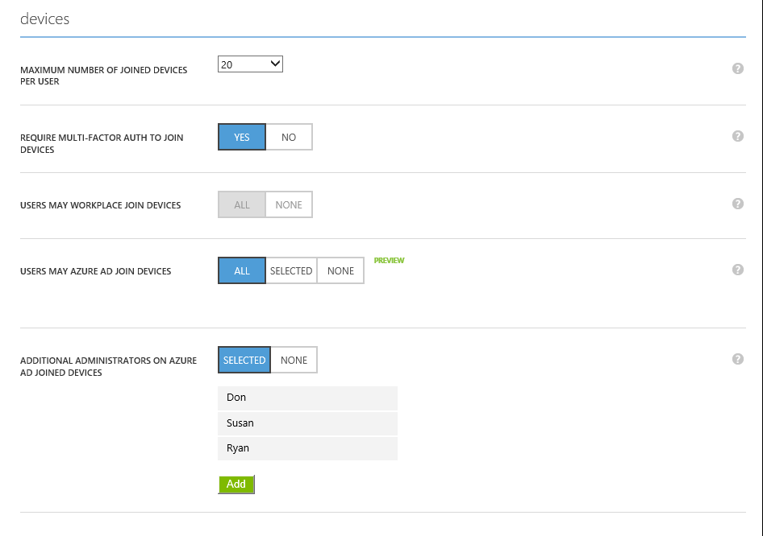

Slide 33
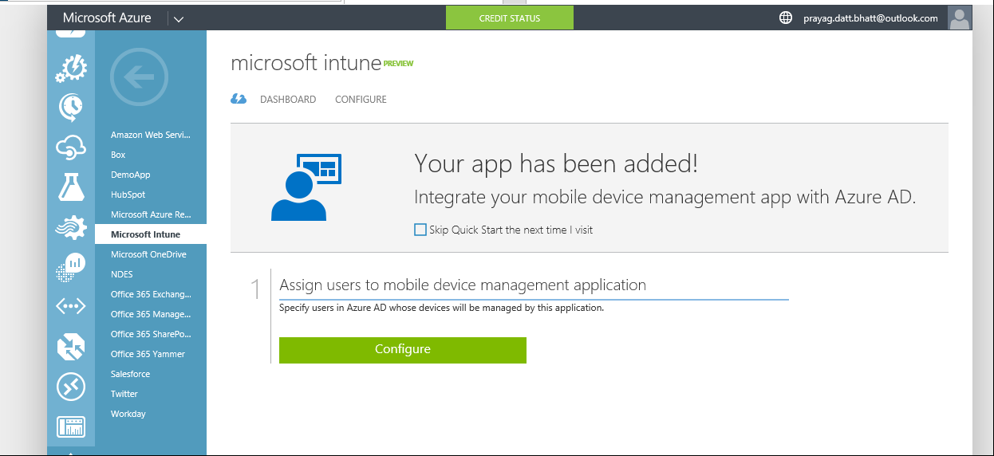

Slide 34
SSO in Hybrid Setup

Slide 35
Microsoft Azure
Active Directory
OneDrive
Office 365
Intune
Dynamics
Azure AD
Connect
SCCM Intune
Hybrid Connection
Windows Server
Active Directory
System Centre Configuration Manager

Slide 36
Microsoft Azure
Active Directory
OneDrive
Office 365
Intune
Dynamics
Primary
Refresh
Token
Username
Password
PRT
Username
Password
TGT
Kerberos Ticket
Windows Server
Active Directory
System Centre Configuration Manager

Slide 37
Microsoft Azure
Active Directory
OneDrive
Office 365
Intune
Dynamics
SSO Token
Kerberos Ticket
PRT
TGT
Windows Server
Active Directory
System Centre Configuration Manager

Slide 38
Management Labs Module 01-01: Azure AD & EMS setup and configuration

Slide 39
Getting Ready for Windows 10
Set up Azure Active Directory
Get current with System Center Configuration Manager and Windows Server
Consider mobile device needs
Think about scenario-based management
Notes:
[Call to Action]

